Slide 1
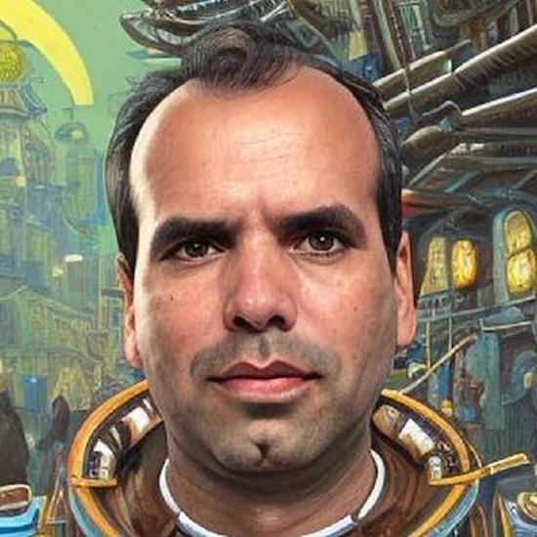
Autonomy vs. Standardization Platform Engineering, CNOE
Devops day Raleigh, April 11th 2024
Carlos Santana
(he/him)
Sr. Kubernetes Solutions Architect
AWS

Slide 2

Standardization vs. Autonomy: The Platform Engineering Balance
Autonomy?
Standardization

Slide 3


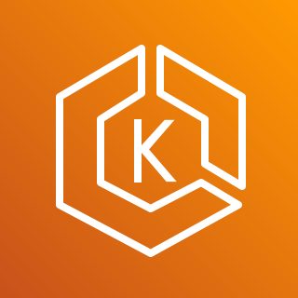


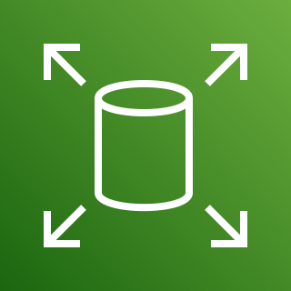


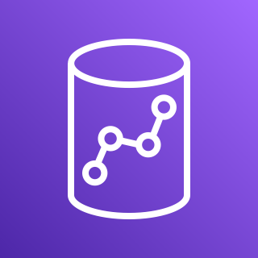
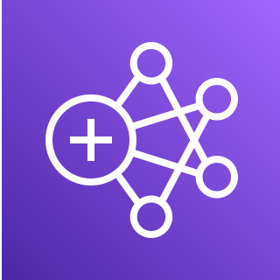
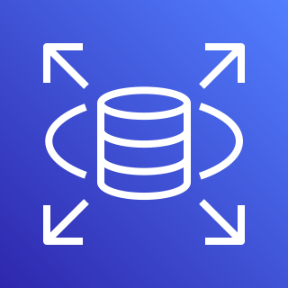
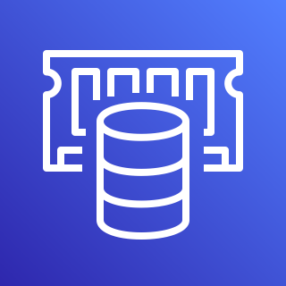
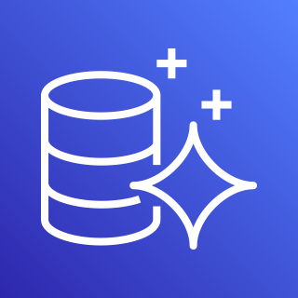

Teams
Applications
Infrastructure
Amazon EKS
Amazon EC2
Amazon S3
Amazon EBS
ELB
Amazon Route 53
Amazon Redshift
Amazon EMR
Amazon RDS
ElastiCache
Amazon Aurora
Amazon SNS
Notes:
Ok great, so if you are leading platform or cloud adoption at your organization, you are responsible for enabling your organization to run applications in the cloud. This can include building net new, migrating, or modernizing applications. You will have a wide range internal customers who are software teams. These internal customers are building or maintaining one or many different applications that will need to run or be modernized in the cloud. And to do so, each of these applications will require a wide range of cloud infrastructure service. This of course is going to include compute services like EKS, but it will also include application dependencies such as an RDS database, or an S3 bucket, an EBS volume, observability and monitoring services etc. But the point being, each app depends on a lot of cloud infrastructure. Additionally, not every application is the same, they are heterogeneous and have different infrastructure requirements. Some might require more compute than others. Some may require different instance types. But regardless, all or most of the applications will need to be either migrated to or modernized in the cloud and you need to determine the strategy by which your organization will do this, ideally in a cost effective manner. How many of you folks who mentioned you lead platform engineering organizations find yourselves in this situation?

Slide 4


Infrastructure management spectrum
Decentralized
Application teams deploy and maintain their own infrastructure
Centralized
Infrastructure is completely managed on behalf of application teams
Notes:
So you all have a choice to make. Who is going to be responsible for provisioning and managing the infrastructure that is needed to run these applications. I think about this choice along what I like to call the infrastructure management spectrum. On one end of the spectrum, you can attempt to decentralize infrastructure management responsibilities...
On the other end of the spectrum you can choose to centralize infrastructure management responsibilities...
Platform Engineering conceptually skews towards the right end of this spectrum. It is all about building abstractions that allow application teams to offload infrastructure management responsibilities, so that they can focus on their applications.
But in reality the abstractions the platform engineering teams we work with in the EKS world vary significantly and fall at various points along this spectrum. And that's because the requirements of each organization and each application team are unique. Some applications teams want more infrastructure control, some organization have more stringent compliance requirements. So to be a bit more precise, Platform engineering is the practice of identifying and building infrastructure abstractions that meet the unique requirements your internal customers and your organization to enable the efficient, cost effective, and successful adoption of the cloud at scale, and ultimately accelerate the pace of software delivery.
Extra
In this model, each individual application team is responsible for provisioning and managing the infrastructure that is needed for their applications, hopefully with some guardrails in place. The implication here is that every team will need to have expertise and individuals who are capable of deploying, maintaining and perhaps most importantly, troubleshooting production grade cloud infrastructure that is needed to run the application. This model is sometimes referred to ash shift left, embedded SRE, or you may sometimes hear Amazon folks referring to this as the “you build it you run it” approach to infrastructure management
In this model, the cloud infrastructure that is needed to run an application is composed into higher level abstractions which are then offered to internal application teams as a service. The key component here is that this model removes the need for every application team to have cloud infrastructure expertise, effectively allowing them to outsource their infrastructure management needs to this central team.

Slide 5


VS.
Notes:
So lets talk about abstractions for a moment and why they are so valuable in cloud context. I think think this is a really great visual to illustrate that point. On the left you have a bunch of parts for an engine, which you can think of as representing infrastructure resources. And on the right you have an fully built engine sitting in a car, which you can think of as a platform abstraction.
Sure, there are a number of people in this world who capable of building the parts into an engine and then installing it in a car, but it is labor intensive, it takes time, its complex, and most people just want the engine put together, installed in their car so they can drive away. In a cloud context, of course, there are wide range of people in the world who can build and manage cloud infrastructure. Many of them are in this room. But there are a much larger number of application developers who don’t want nor should they need to worry about cloud infrastructure. They just want to focus on building their application and delighting their end customers. Platform engineering is really the practice of building abstractions, that meet your customers where they are, and enable them to offload the infrastructure management responsibilities that make sense for their workload.

Slide 6
Customer examples on EKS
Notes:
So who is doing this? Well we have a wide range of customers on EKS. And again, the majority of the customers we work with are building internal platforms. So in the EKS world, we see this every day. I like to tell our teams internally, the EKS customer is the platform engineer. And I’ll cite a few specific ones.

Slide 7


Notes:
The New York times have build an internal development platform, where they use mutli-tenant clusters, exposing a catalog thru Backstage and allowing the provision of new cloud accounts. Once the clusters are deployed they use ArgoCD to deploy their workloads and give access to their developers using the platform CLI to simplify access when they need to access their workloads for troubleshooting and take deeper look into observability data

Slide 8


Notes:
NASA chose AWS and EKS to serve as the foundation for their new data platform.
Built with tools like JupyterHub, Dask, Crossplane, and Flux CD – the platform allows scientists to provision a complete, batteries included, jupyter environment running on EKS in minutes.
This new platform aims to enable scientists from around the world to collaborate by sharing data and processes, and generating reproducible results.
The ultimate goal of the platform is to provide “scientific models as a service,” a way for researchers around the world to execute common scientific models directly from a familiar interface. This platform is super cool because it supports the White House’s Office of Science and Technology Year of Open Science initiative which is a movement that aims to make scientific research more transparent, accessible, and collaborative. We are thrilled that NASA chose to build on top of EKS.

Slide 9

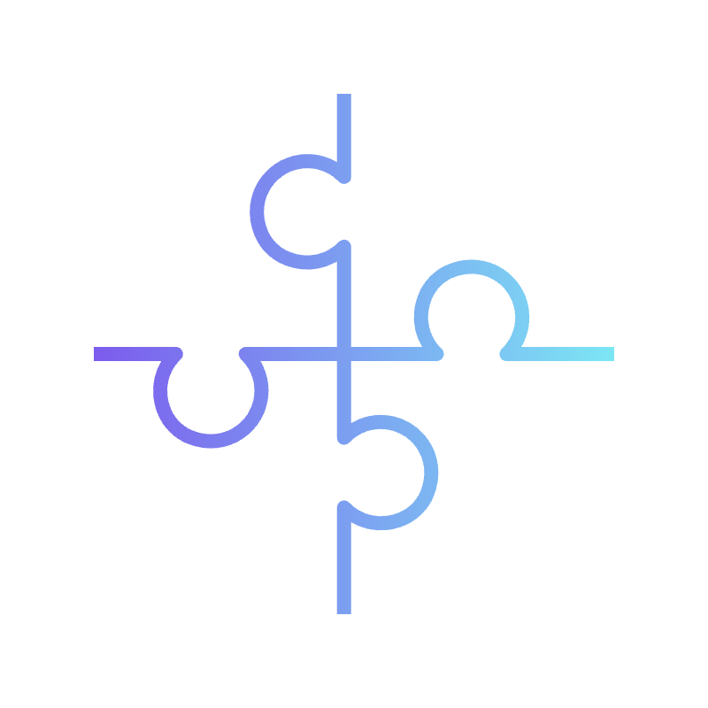

Customer benefits from building an internal platform
Velocity
Governance
Efficiency
Reduce the time it takes to get new applications in front of customers
Ensure application teams operate safety and securely in the cloud
Optimize spend via efficient resource utilization and specialization
Notes:
Building an internal platform is an investment. There is an upfront cost that will hopeful enable a number of benefits once the platform is in place. So lets talk about the benefits we see customers achieving from their platform investments. The first thing we hear from customers is velocity. They are able to reduce the time it takes to get ideas, innovations, and really code from a developers laptop, onto the cloud and into the hands of a customer. By removing the need for each team to provision and manage their own infrastructure and by providing self service deployment capabilities - companies accelerate time to market for new ideas. The second is Governance. And in this context governance is sort of a catch all for things like security, reliability, scalability etc. By building abstractions, companies are able to enforce their governance requirements in an automated way for all applications running on the platform. So every workload benefits from built in sensible defaults, and application teams don’t have to figure out how to configure these on their own. And finally, efficiency, and this is really about reducing cost. Platforms help customer save cost across in a number of ways, and I’ll hi light a few. First, from a compute efficiency perspective, platforms especially in a containerized multi-tenant setting, allow customers bin pack applications on the same underlying instances and make better use of their compute spend. Second, is human capital cost. By centralizing expertise and building abstractions that many different teams can use, customers reduce the number of humans that need to be embedded in applications teams to run in the cloud.

Slide 10
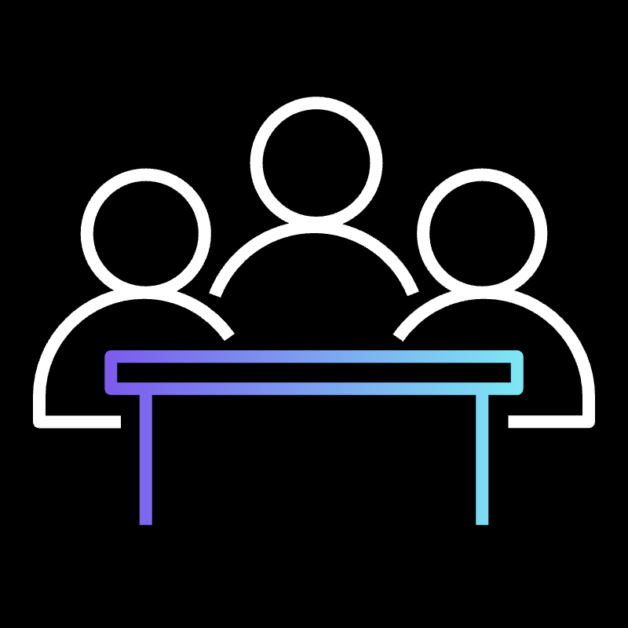

Let the battle begin !!!!
Platform builders
App developers & data scientists
Standards
Autonomy

Slide 11

Autonomy and standards
Developers and data scientists want
AUTONOMY
Platform engineering teams want
LEVEL OF STANDARDIZATION

Slide 12




Challenge areas
Ownership
Level of abstraction
Adoption
Troubleshooting
Notes:
Ownership ?
Abstraction Level ?
Build it and they will come ?
Troubleshooting my application ?

Slide 13
Example: I want my app to run in isolation
Account
Region
Availability
Network segmentation
Clusters
Compute
Namespace
Virtual clusters
What do you mean by isolation?
Notes:
Now to reduce even more the surface area, and the blast radius impact of a possible attack, is understanding and defining a multi tenancy that can fit your requirements, based on Isolation Factors, that can be workloads that need to run on privileged mode or that have code that are not managed by you, and you want to run apart form other workloads, or even resource requirements, for example any GenAI application that may be GPU intensive, and need specific hardware to run. Once you define those factors, you can decide what isolation method works better for each one, that can be, accounts or network segregation for those privileged workloads, or different nodes for the GPU intensive, or even if you want to increase your resiliency with multi-region or availability in multiple-AZs. It all depends on what best fit your needs.

Slide 14


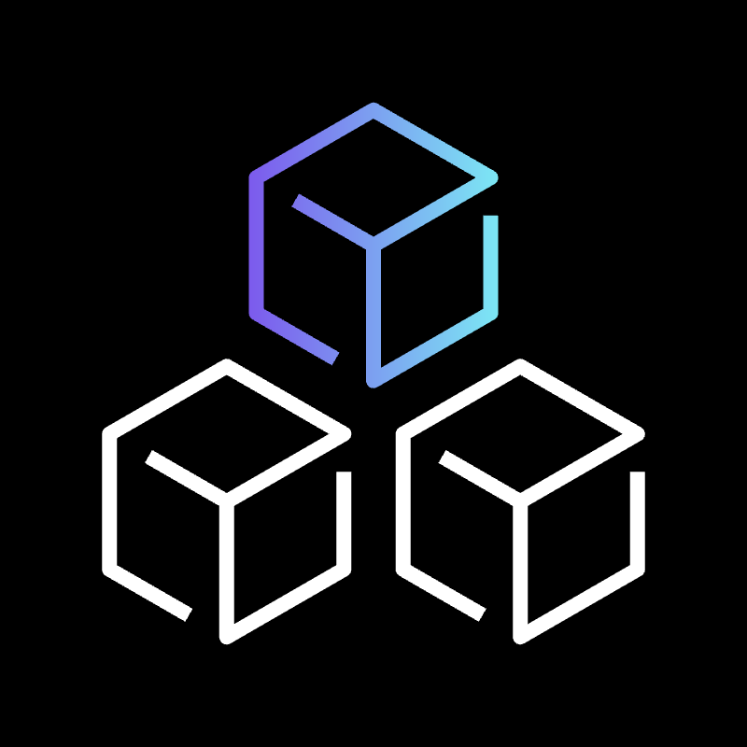
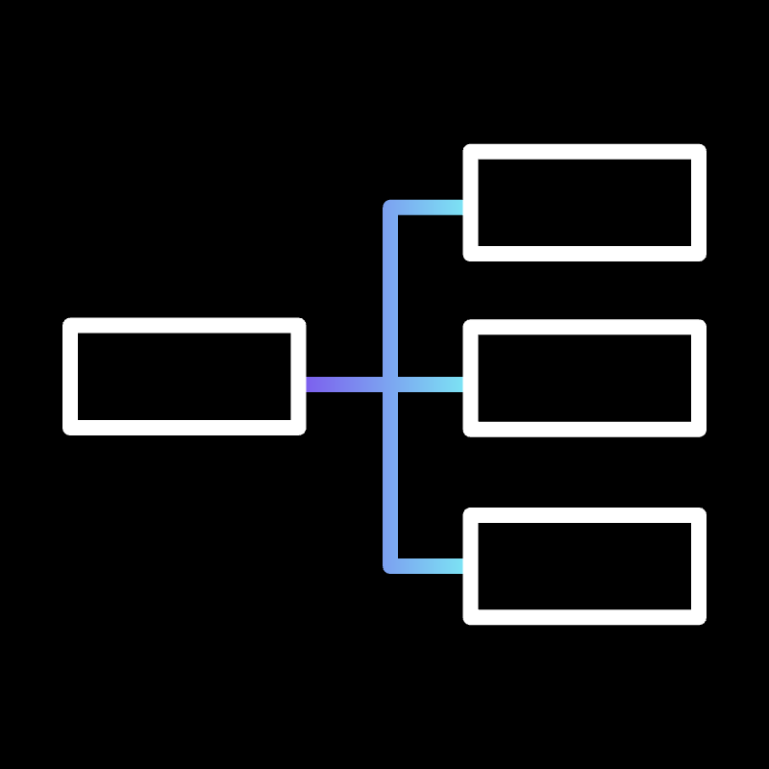
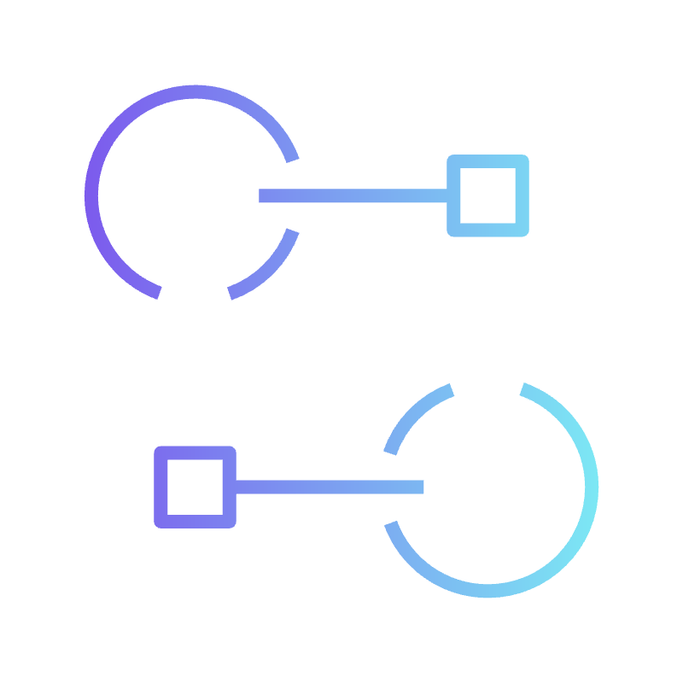
Platform design patterns
Account
as a Service
Template
as a Service
Cluster
as a Service
Namespace
as a Service
Platform
as a Service

Slide 15







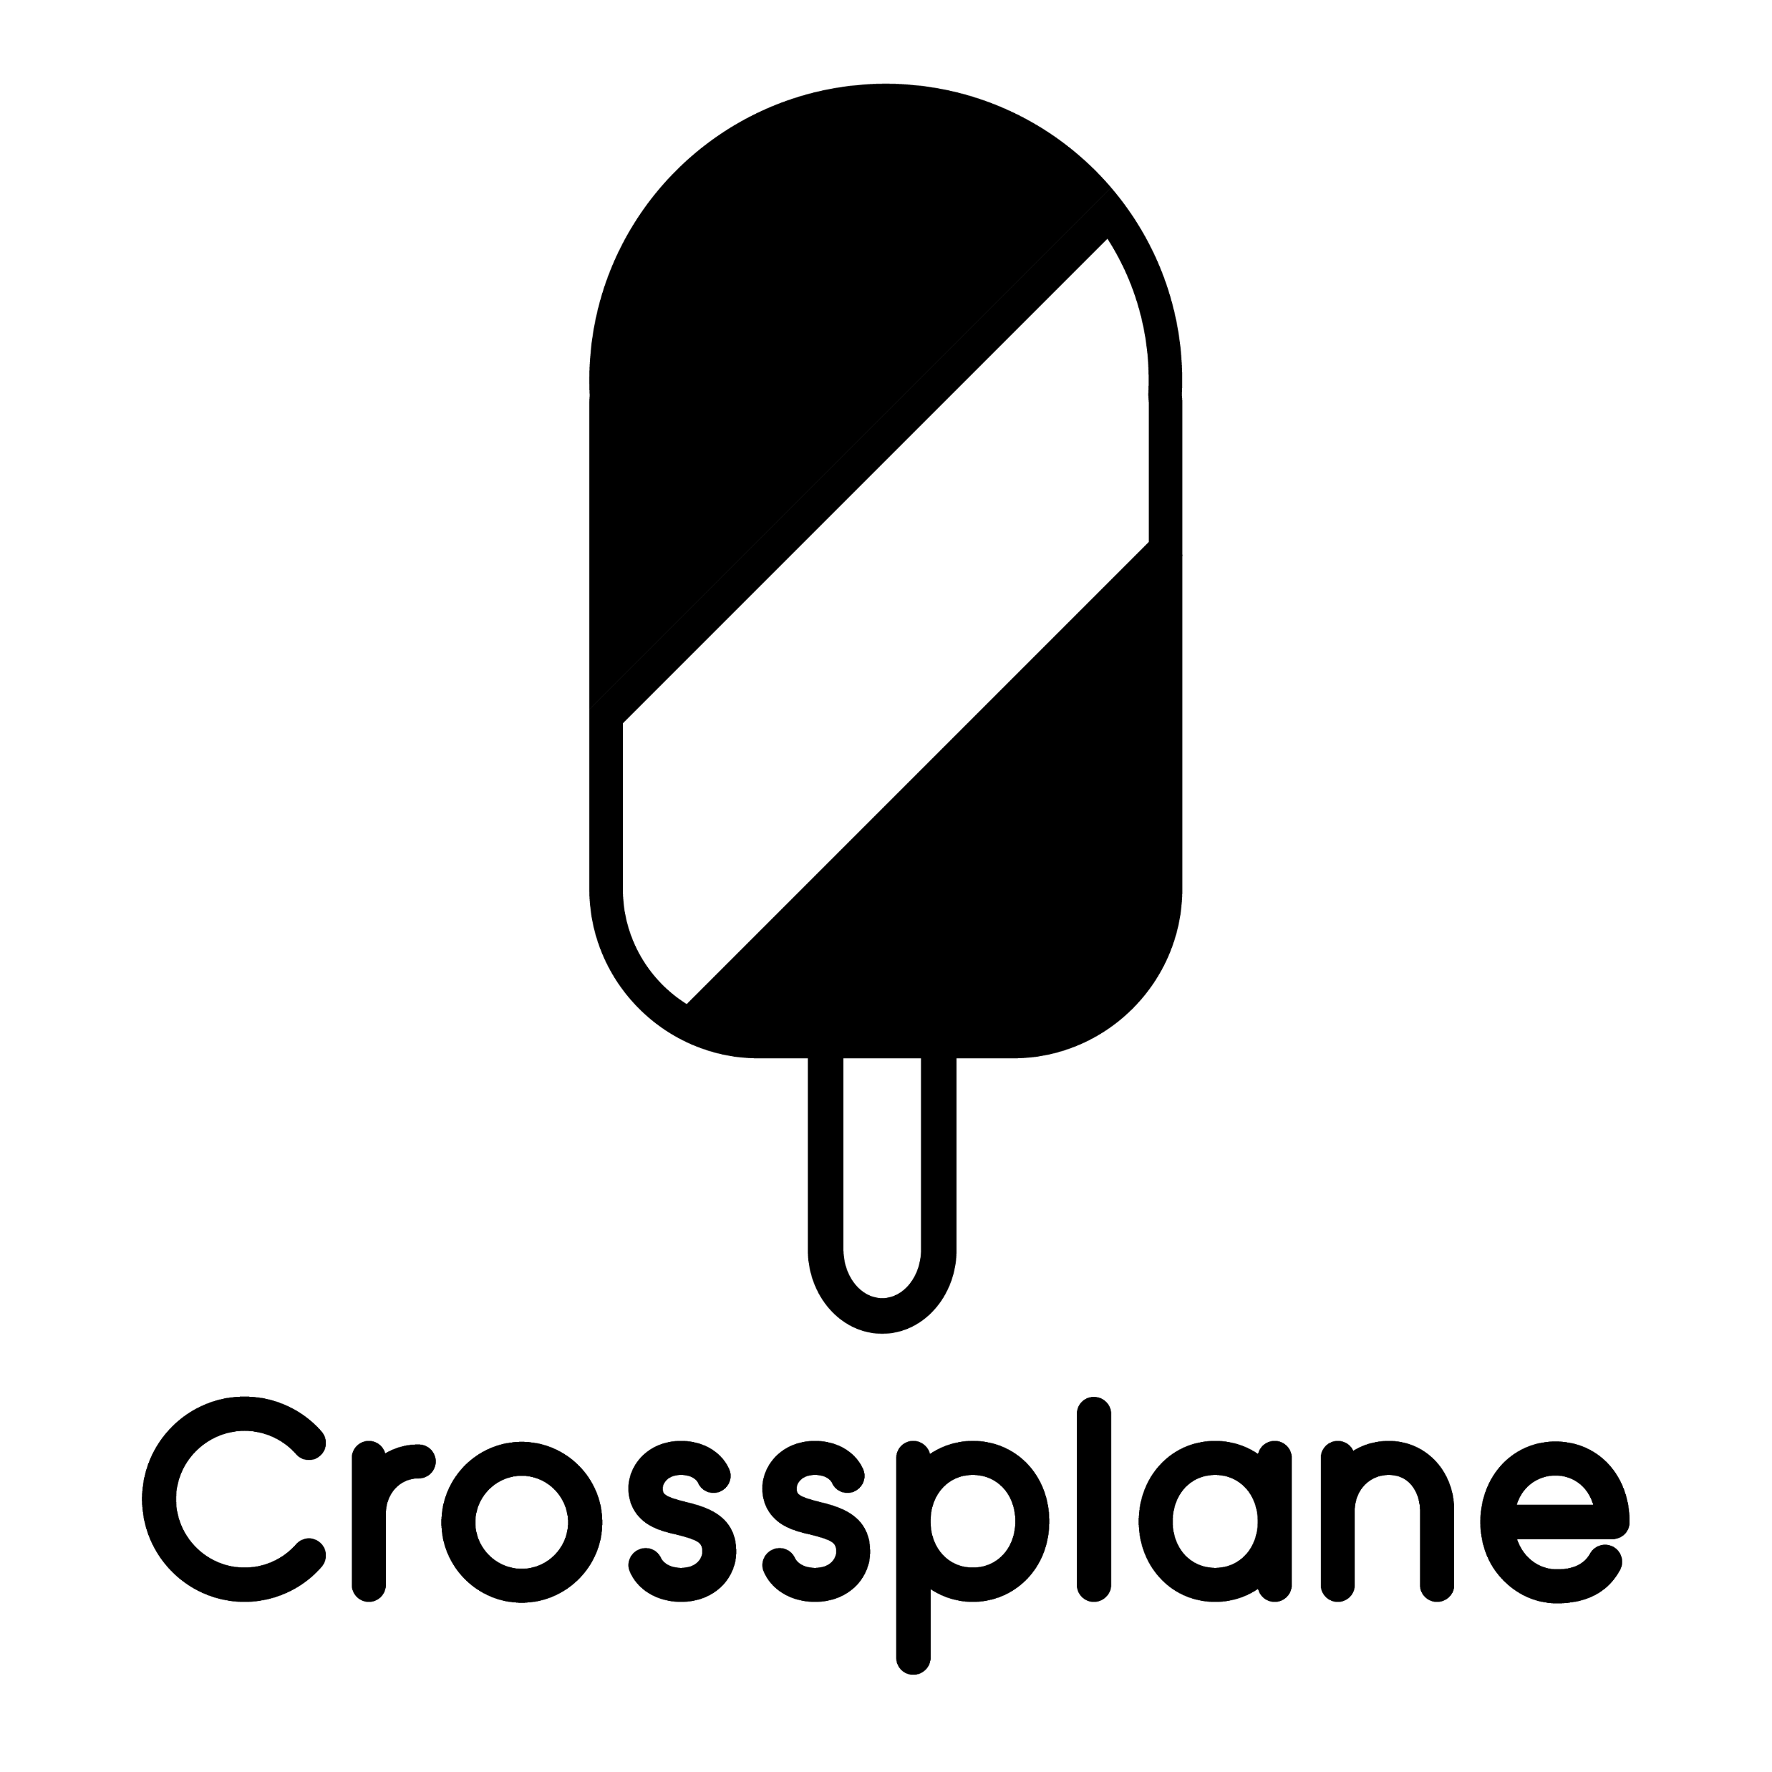






Building a platform with Kubernetes in practice
Central AWS account
provision
Tenant AWS Account
EKS Cluster
AWS API
5
RDS
S3
System Namespace
Tenant Namespace
2
webhook
4
OPA
Resource CRDS
ALB
SQS
Repo
6
3
EKS Cluster
K8s Control Plane
git push
1
7
API Server
Admission Controller
Pods
Pods
Devs
Notes:
Writing your first Crossplane composition can be intimidating especially when you are new to K8s eco system. To help with our customers with this, we have created a GitHub repository.
This repository contains bootstrap instructions as well as compositions to get you started. Everything you need to get started with Crossplane is available in this repository.
We offer two modes of bootstrapping, terraform and eksctl. You can use whichever one you like to get started.
Once you have an EKS cluster with Crossplane running, you can start experimenting with one of examples. We provide compositions and example claims that you can use. We will show a quick demo of them after this slide.

Slide 16

A Linux distro
is an operating system made from a software collection that is based upon the Linux kernel and, often, a package management system.

Slide 17
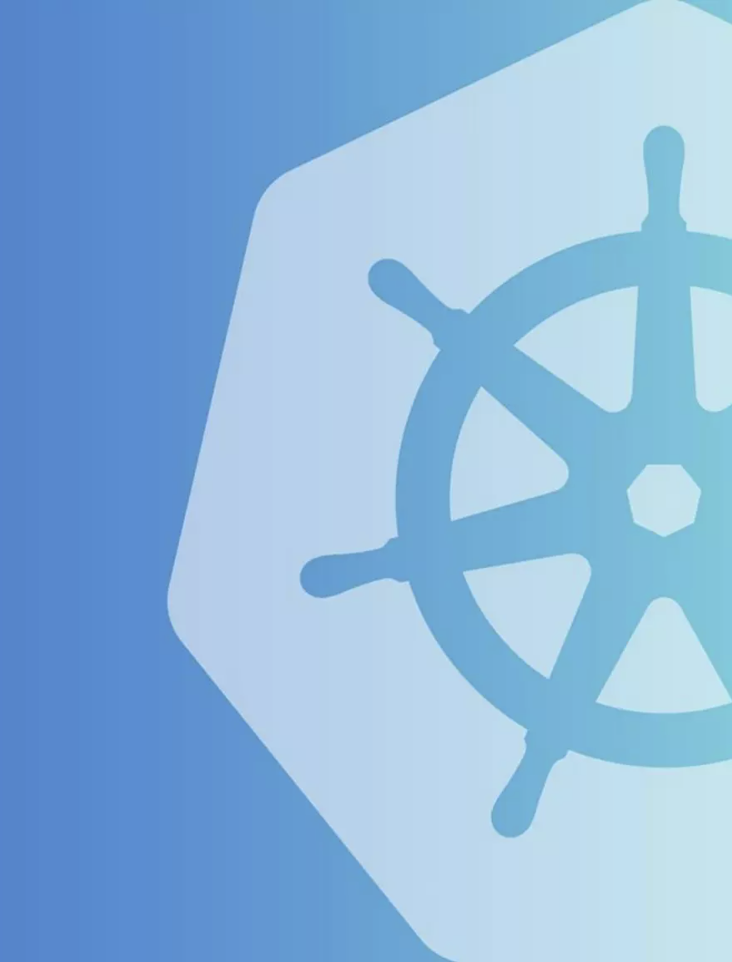
An IDP Distribution
is a developer platform made from a software collection that is based upon Kubernetes, as well as a package management system.

Slide 18
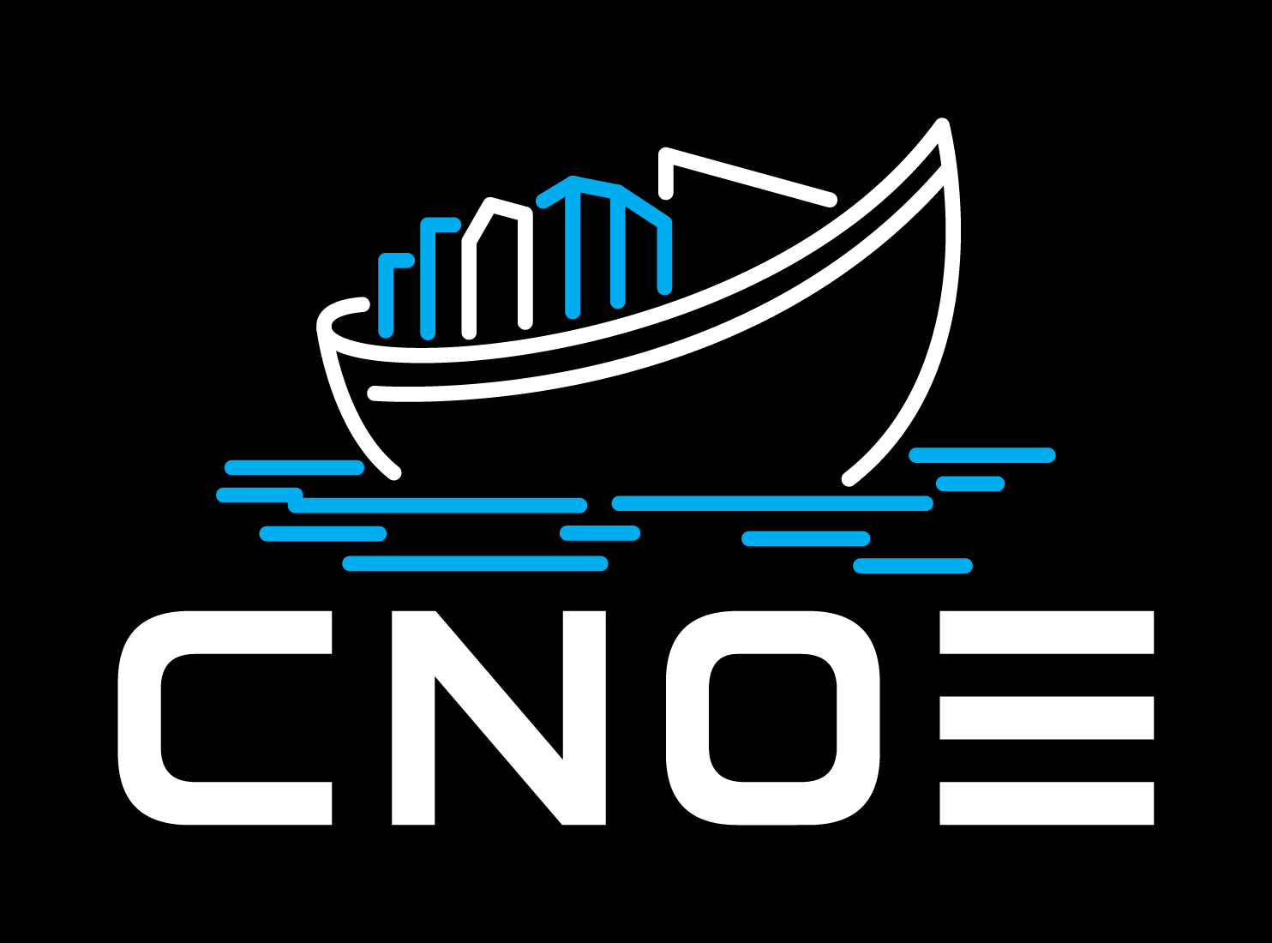
CNOE is an internal developer platform (IDP) distribution built in the open in collaboration with the user community powered by CNCF technologies

Slide 19
Accelerate building your IDP

Slide 20
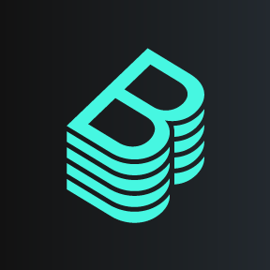
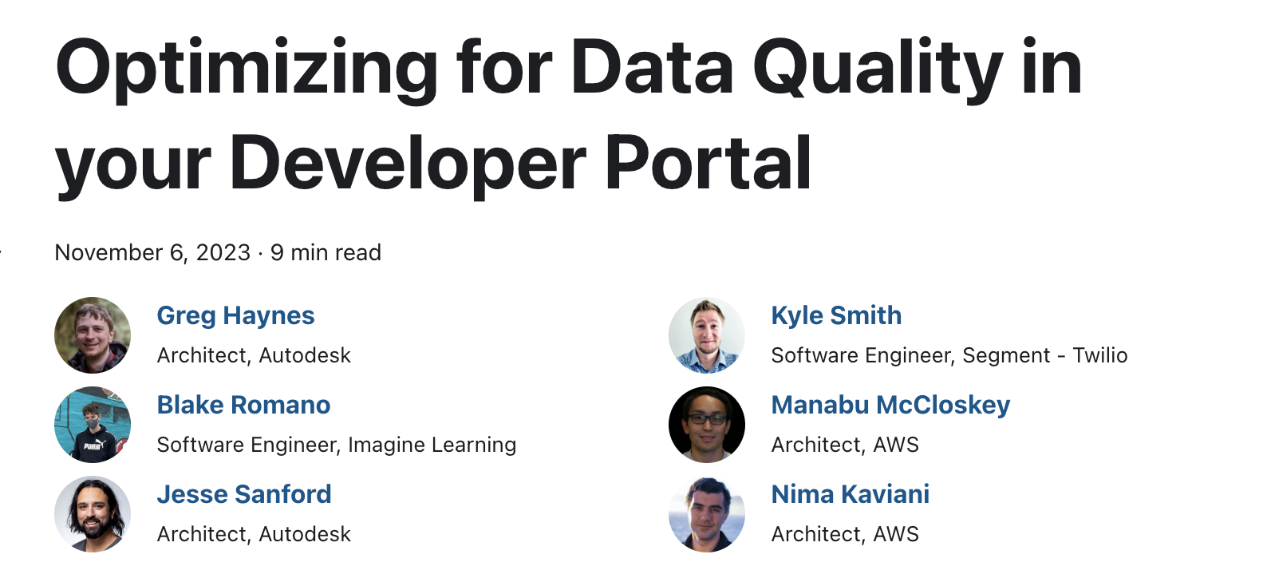
Developer Portal Best Practices
Backstage plugins
Developer practices
https://cnoe.io/blog/optimizing-data-quality-in-dev-portals

Slide 21

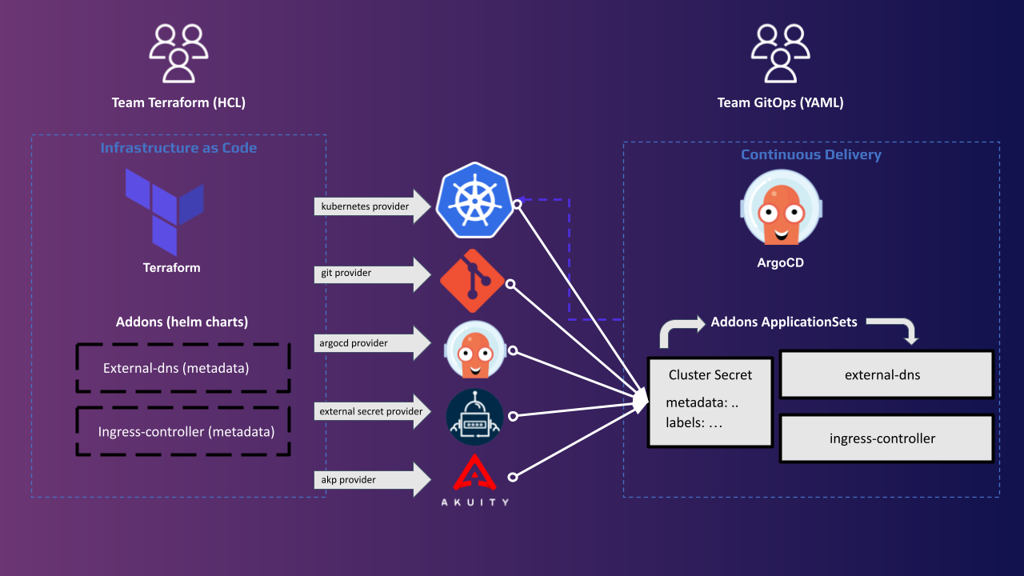
GitOps Bridge
https://github.com/gitops-bridge-dev

Slide 22
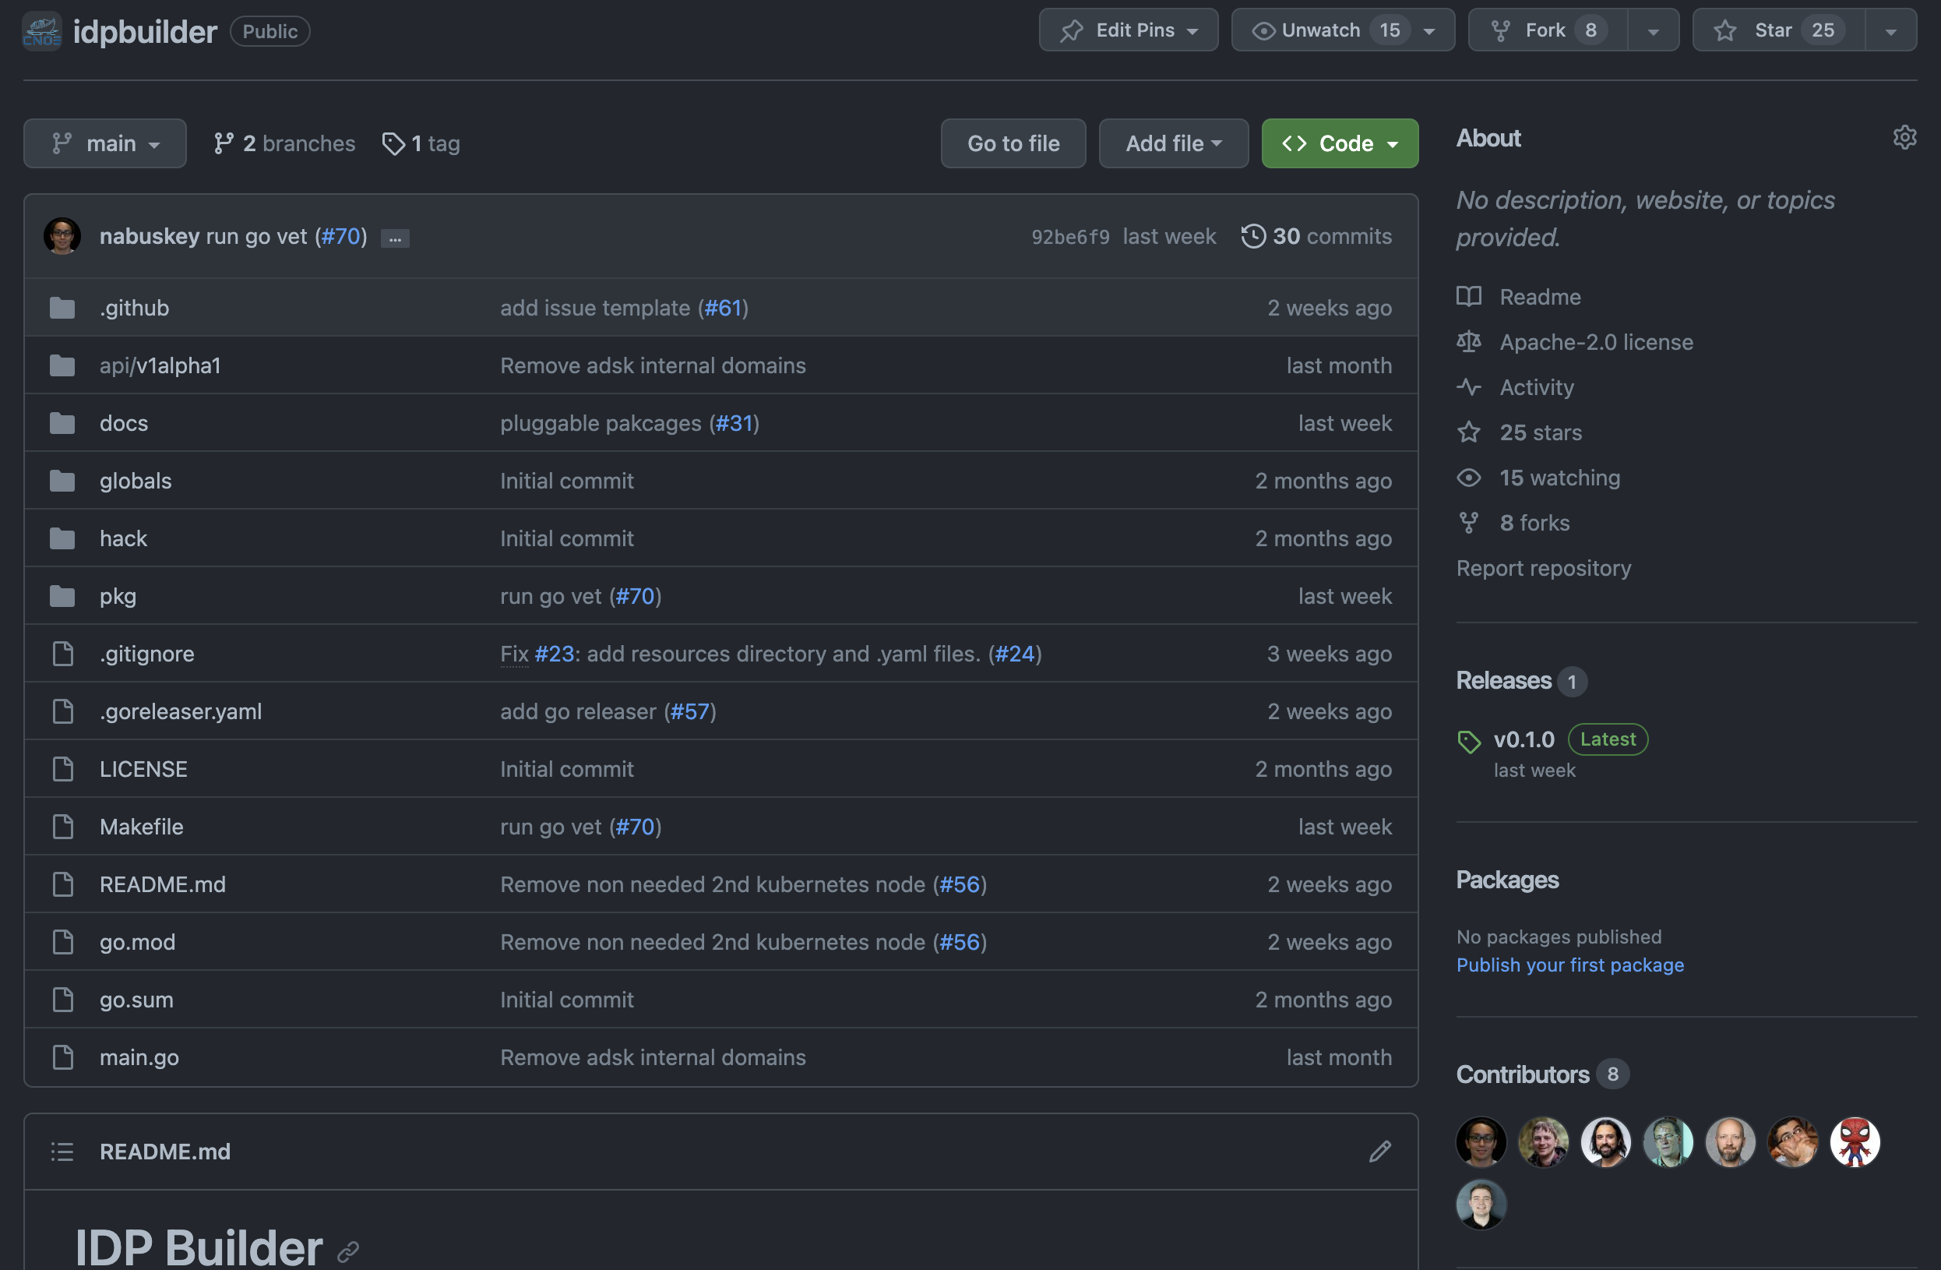
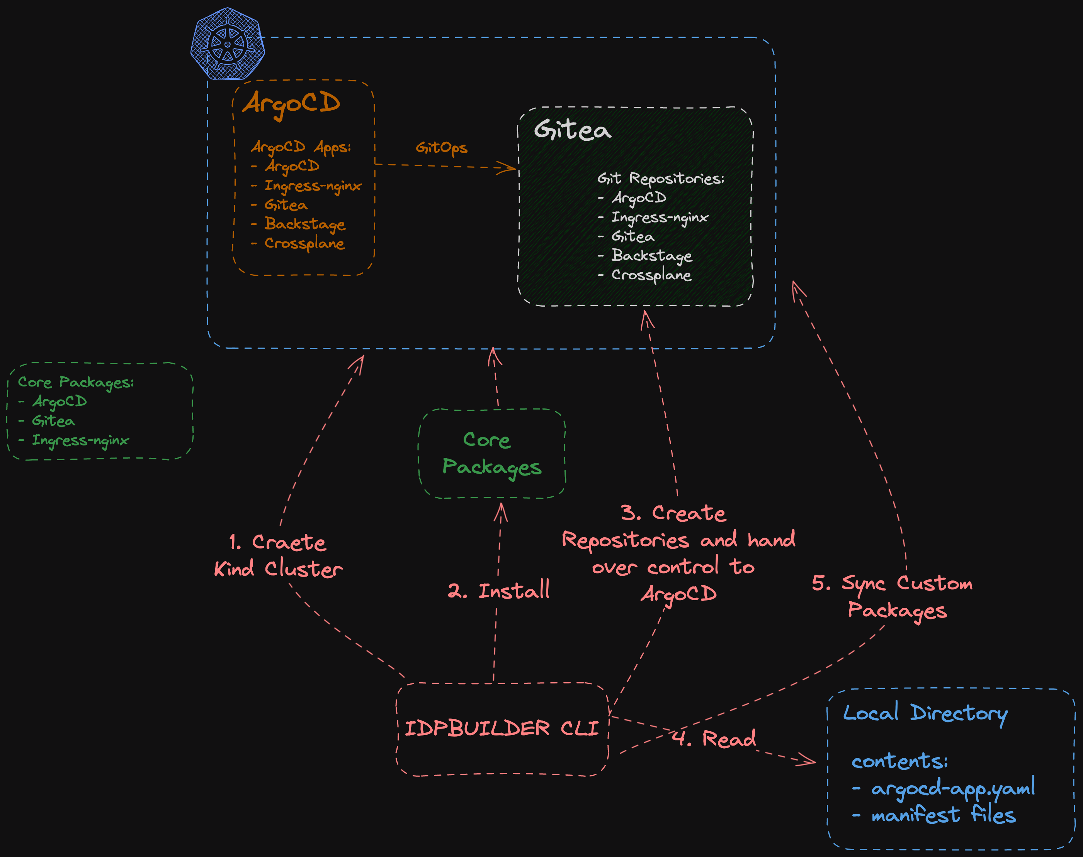
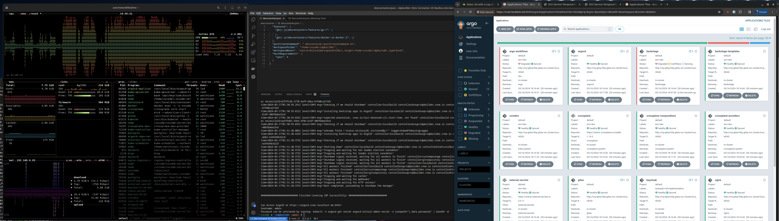
idpBuilder
github.com/cnoe-io/idpbuilder

Slide 23
Platform best practices / guidance

Slide 24

Build with your customers

Slide 25

Documentation and education are key

Slide 26

Don’t boil the ocean

Slide 27

Provide escape hatches

Slide 28

One size doesn’t fit all workloads

Slide 29




Thank You!
Survey
Carlos Santana
csantanapr
csantanapr
csantanapr
https://forms.gle/yvNCmf4SCR4HE9xV9

